Slide 1

SnackTrack
How to make food tracking
more attractive
START Hack Challenge 2024

Slide 2
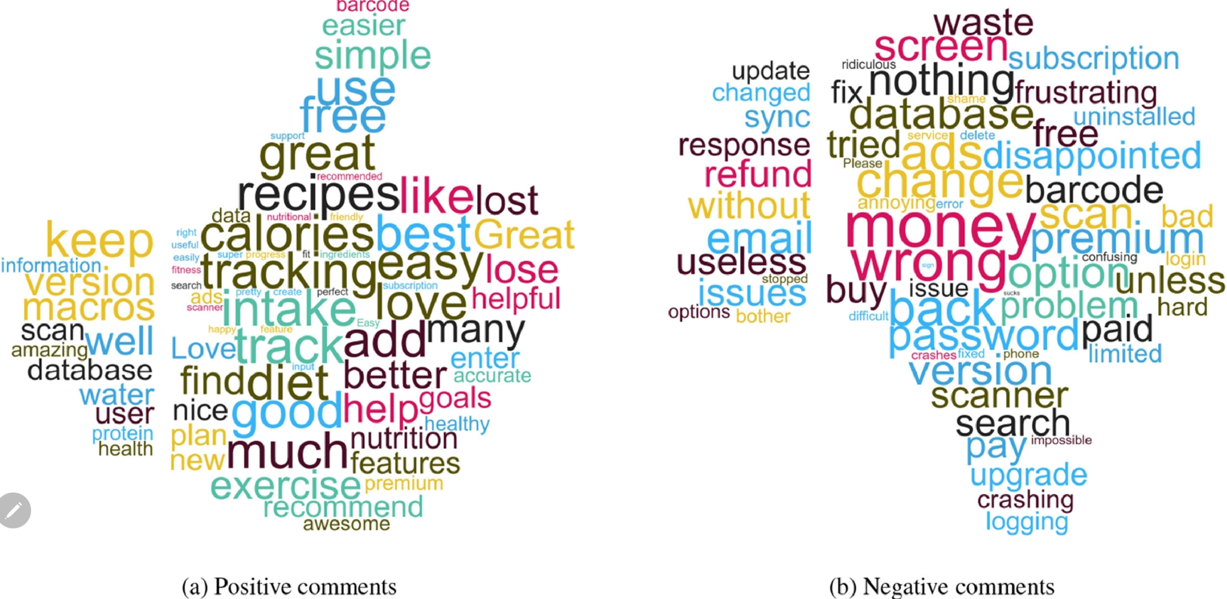
What Makes Food Tracking Apps (un)attractive?

Slide 3
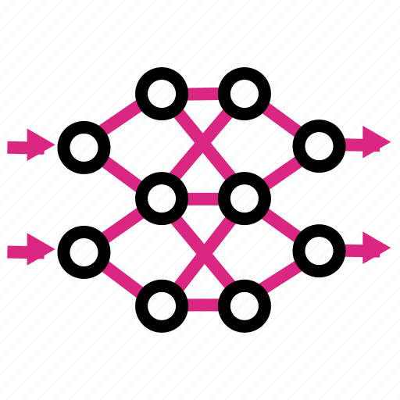
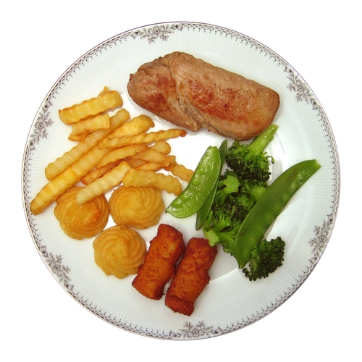
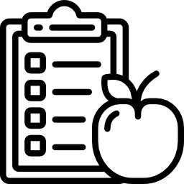
Usual (Poor Performing) Approach to Tracking
Image of meal
AI
Nutritional Information
So let’s “help” the food tracker,
Without making the task tedious

Slide 4

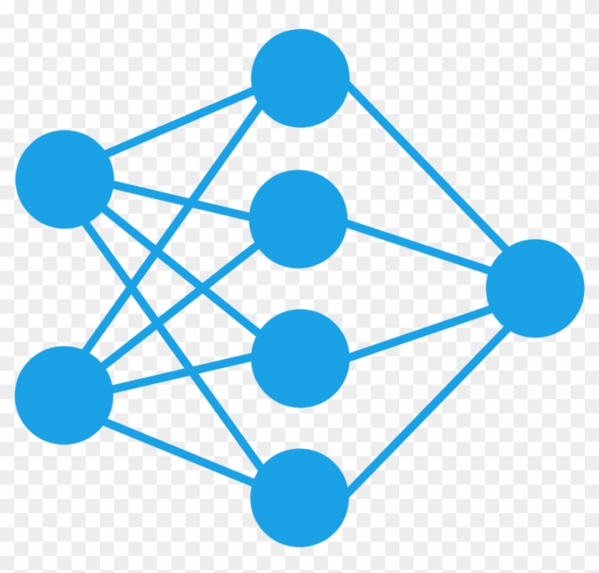


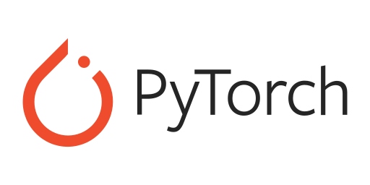
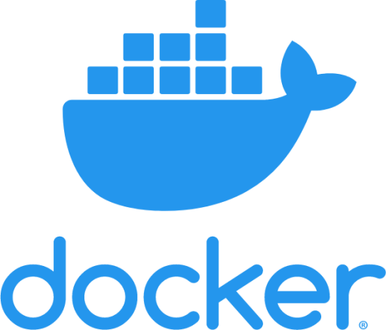
Our Approach
Nutritional
Info
3.
2.
Mass Prediction Model
Orchestrator
1.
Ingredient
Suggestion Model

Slide 5
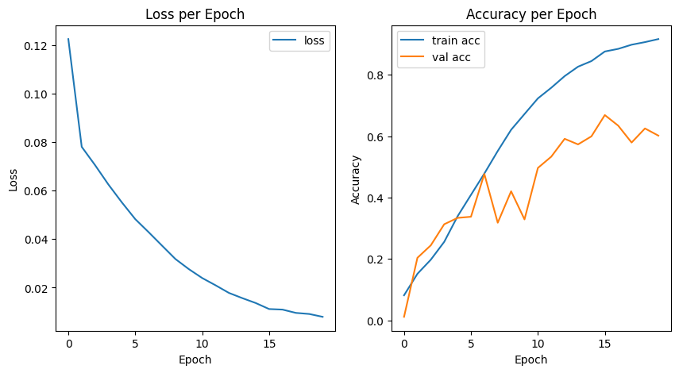
Ingredient Suggestion Model

Slide 6
Quote from Mattia Visigalli,
Innovation consultant at Zurich insurance
“Almost all heath insurances want to develop their personalised healthcare application and almost all of them have in their roadmap a project based on nutrition based project”

Slide 7
UX

Slide 8
Roadmap

Slide 9
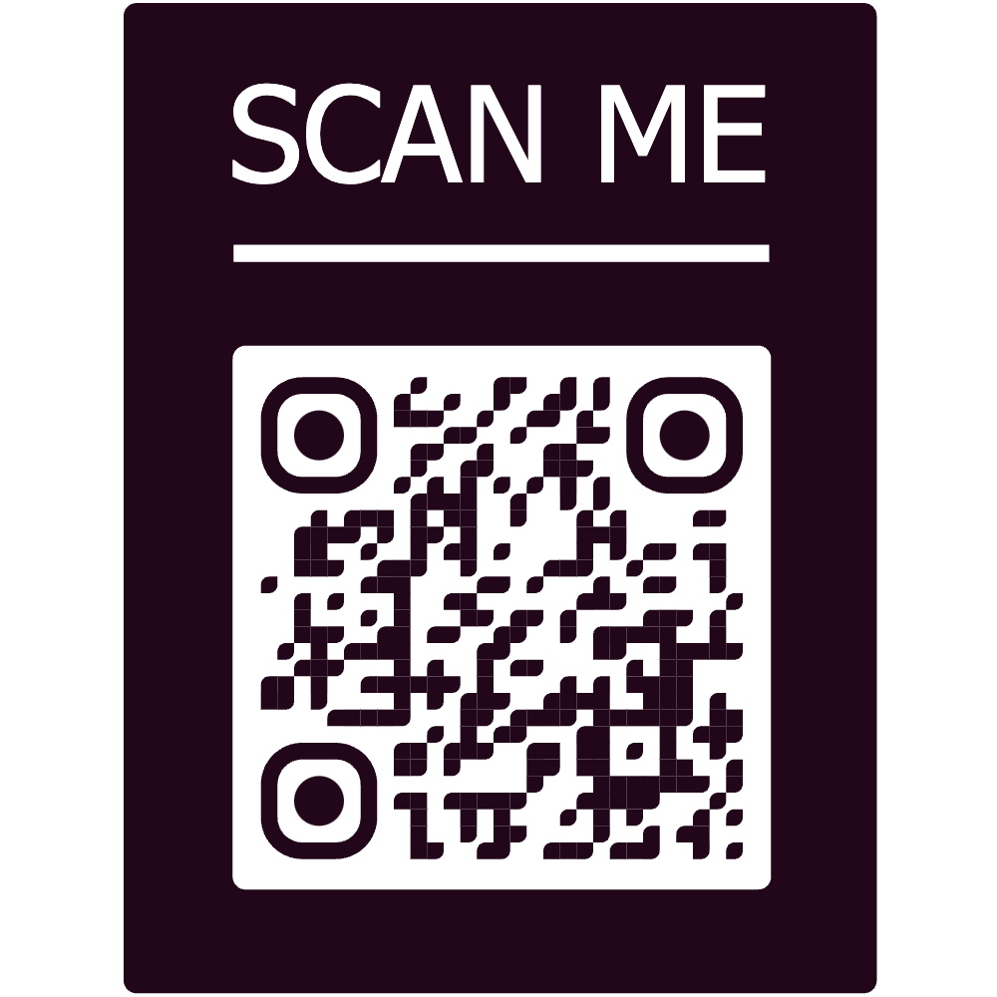

Find our code on GitHub

